Slide 1
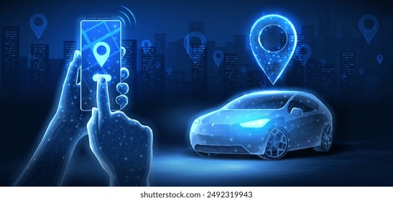
Uber Trip Analysis using Machine Learning
Name: Vadla Rajashekar Chary
Domain: Data Analyst | Machine Learning
Tools: Python, Google Colab, ML

Slide 2
Problem Statement
Analyze Uber pickup data to identify demand patterns
Predict future trip demand using Machine Learning
Help optimize driver allocation and peak-hour planning

Slide 3
Dataset Overview
Dataset Source:
FiveThirtyEight / Kaggle (NYC TLC FOIL Data)
Data Includes:
Date & Time of pickup
Latitude & Longitude
Base (Uber service code)
Monthly data (Apr–Sep 2014)

Slide 4
Tools & Technologies
Languages:
Python
Libraries:
Pandas, NumPy
Matplotlib, Seaborn
Scikit-learn, XGBoost
Platform:
Google Colab

Slide 5
Data Preprocessing
Merged multiple monthly CSV files
Converted Date/Time to datetime format
Sorted data chronologically
Resampled data to hourly trip counts

Slide 6
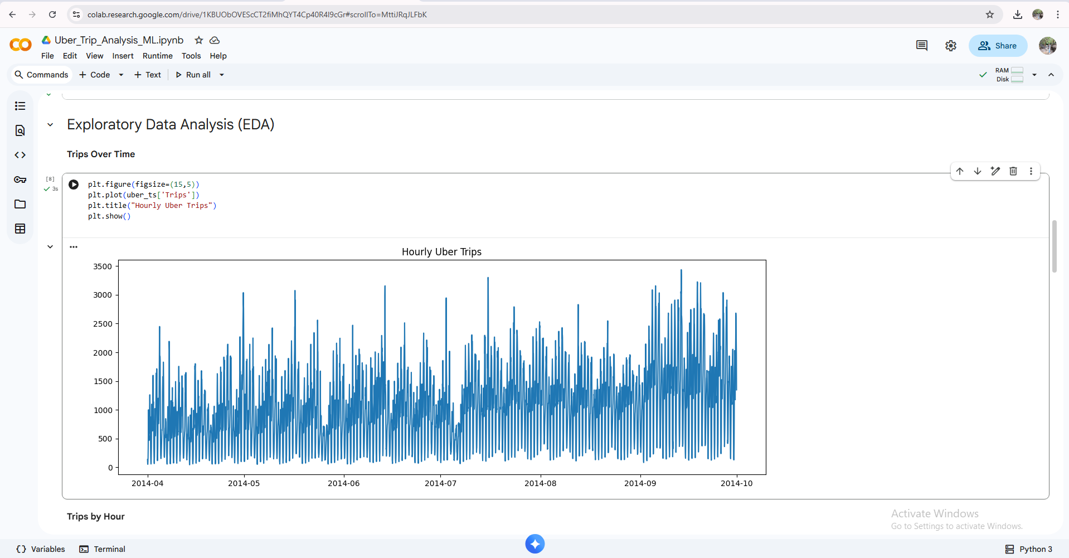
Exploratory Data Analysis (EDA)
Trips Over Time

Slide 7
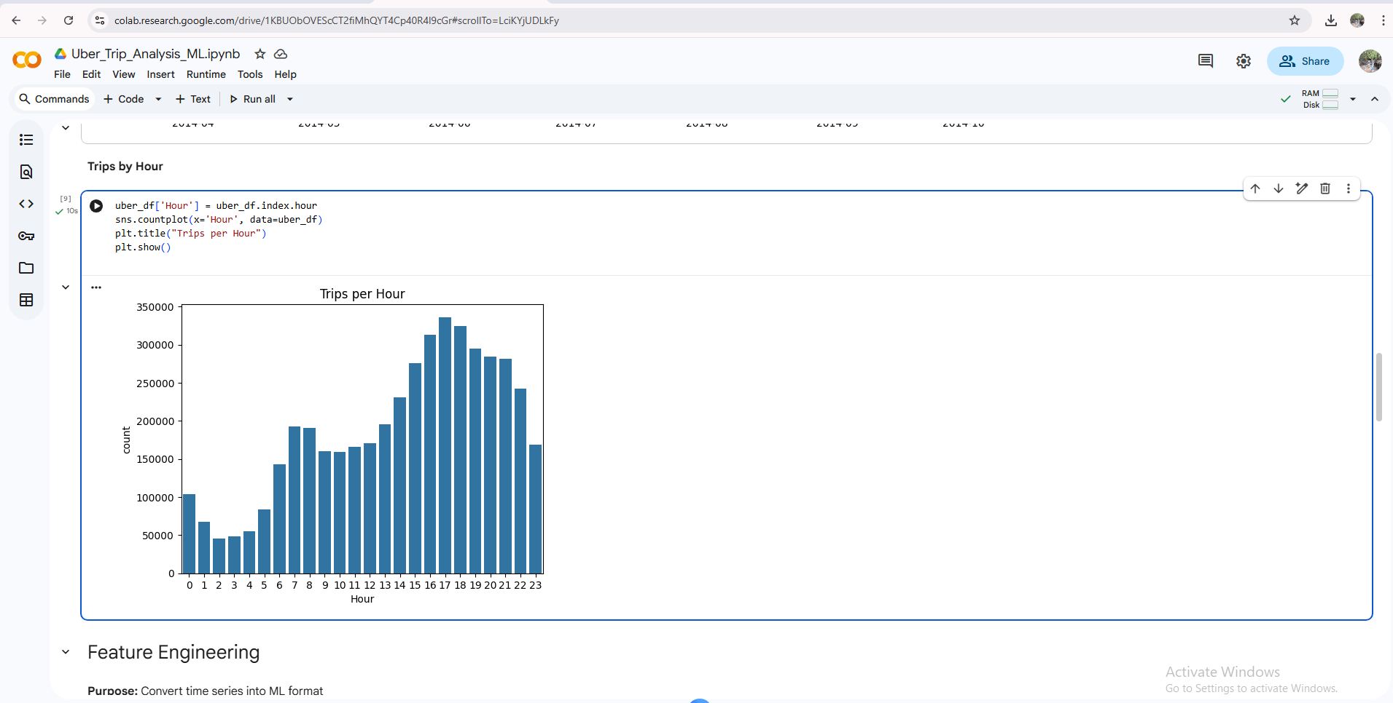
Trips by Hour

Slide 8
Feature Engineering
Techniques Used:
Created lag features (previous 24 hours)
Converted time series into ML-ready format
Defined target variable: Hourly Trips

Slide 9
Machine Learning Models
XGBoost Regressor
Random Forest Regressor
Gradient Boosting Regressor
Ensemble Model

Slide 10
Model Evaluation
Evaluation Metric:
Mean Absolute Percentage Error (MAPE)
Results:
XGBoost → Best performance
Ensemble → Stable predictions

Slide 11
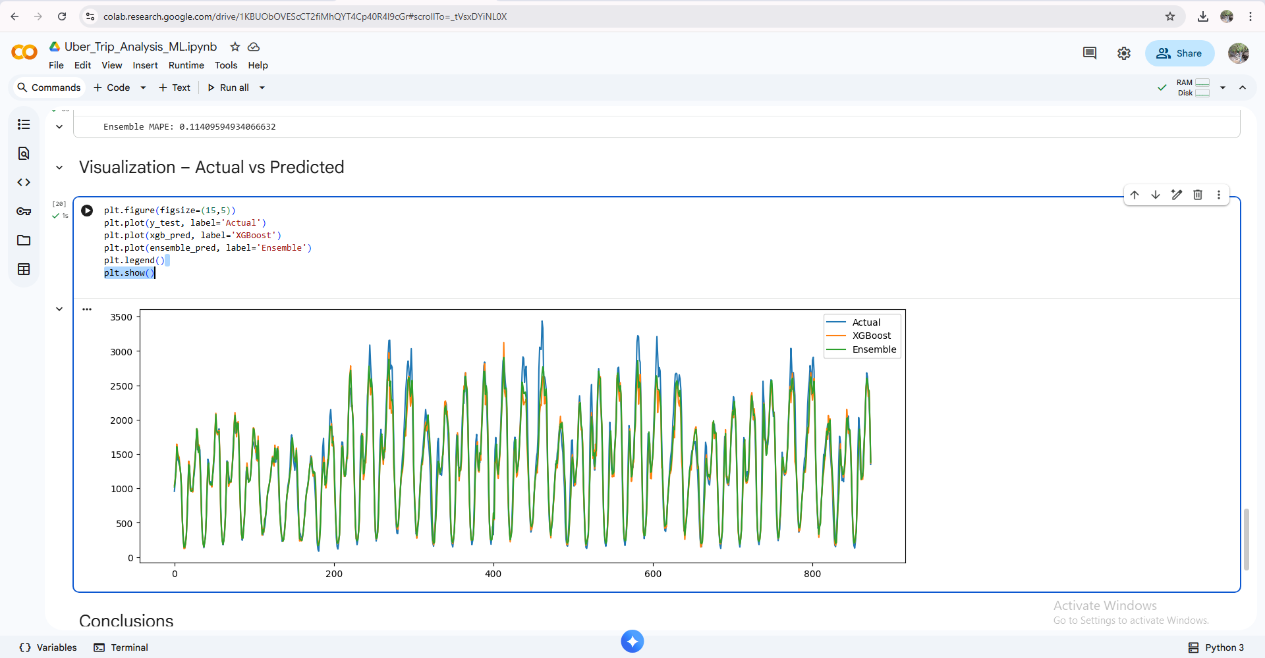
Visualization – Actual vs Predicted

Slide 12
Conclusion
Successfully analyzed large-scale Uber trip data
Built accurate demand forecasting models
Project demonstrates real-world data analytics skills

Slide 13
Future Enhancements
Include weather & holiday data
Use deep learning (LSTM)
Real-time demand forecasting dashboard

Slide 14
Thank You

